Slide 1
Weekly Update #11
Gijs Admiraal

Slide 2
Recap from previous weeks
Started exploring topics: atom-by-atom generation, non-standard amino acids (nsAA), (chemical) language models, data augmentation and 3Di
Brainstormed and written out scenario#2 All-atom in a diffusion setting
Written the research proposal
Finished 10-week deadline

Slide 3
This week?
Integrated feedback of research proposal
Some comments that needed discussion
Trying to get the cluster to work
Bit by bit

Slide 4
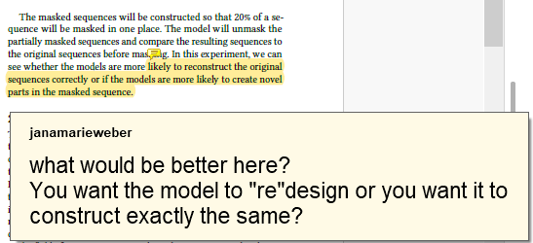
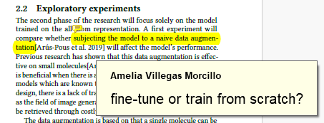
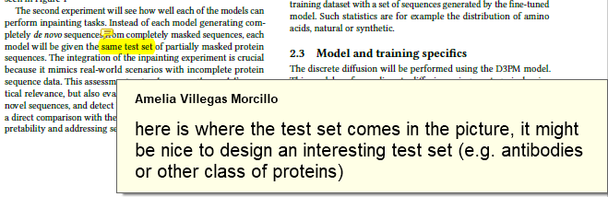
Feedback

Slide 5
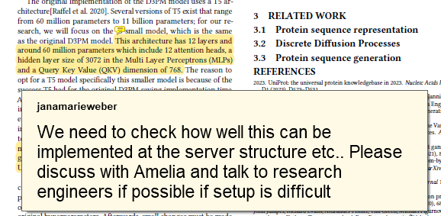
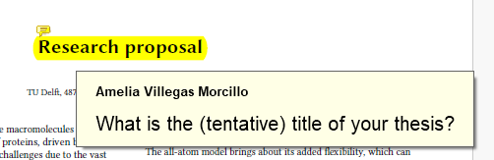
Feedback

Slide 6
Cluster
First had login issues from home
Then had file transfer issues
After that had python version issues

Slide 7
Next week?
Continue working on D3PM

Slide 8
notes
Send email to thesis coordinator
Redefine dates
Look at data augmentation fine tune or from scratch – how is it done in literature
What is high and low level in NLP
Sentences vs letters
Contact research engineers about t5-small and batching
What is their experience?

